Slide 1
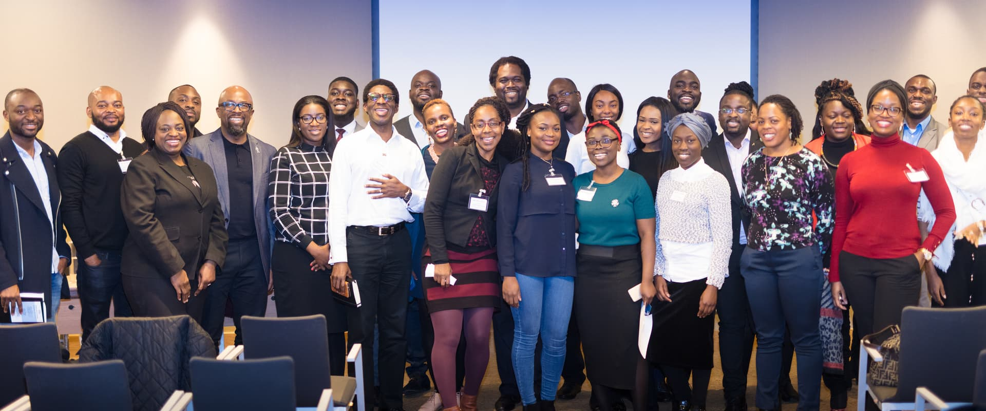
CEE4BEE 2.0
Closing the
Exposure Gap
PEOPLE · PLACES · POSSIBILITIES · OPPORTUNITIES
Talent is everywhere. Opportunity is not.
A social mobility charity closing the Exposure Gap for people from underrepresented and underserved communities.
Registered charity in England and Wales 1174657 · cee4bee.com · info@cee4bee.com

Slide 2
WHY WE STARTED
In 2015 we kept seeing
the same pattern.
Talented.
Hardworking.
Ambitious.
Not a shortage of ability. A shortage of exposure.
· Never met the people
· Never seen the places
· Never understood the possibilities
· Never accessed the opportunities
So we created Cee4Bee. Covid paused the journey. The mission remains.
Founded in 2015 by Dotun Olaleye and Ayo Akande.

Slide 3
THE PROBLEM
Exposure comes before everything else.
People cannot aspire to what they have never seen.
People cannot access opportunities they do not know exist.
People cannot become what they cannot imagine.
LEFT UNADDRESSED, THIS BECOMES A CYCLE
Low exposure
Low awareness
Low aspiration
Few opportunities
Limited social mobility
Each stage narrows the next. Break the first link and the whole chain changes.

Slide 4
THE EXPOSURE GAP
The same talent. A different starting line.
THOSE WITH EXPOSURE
THOSE WITHOUT EXPOSURE
Know professionals
Know few professionals
Visit workplaces
Never visit workplaces
Understand pathways
Pathways unclear
Build confidence
Confidence stays low
Access networks
Limited networks
Greater opportunities
Fewer opportunities
Cee4Bee exists to close this gap.

Slide 5
WHY WE ARE DIFFERENT
Preparing for opportunity is not
the same as discovering it.
MOST ORGANISATIONS HELP PEOPLE
Prepare for opportunity
· Training
· Coaching
· Mentoring
· Employability
CEE4BEE HELPS PEOPLE
Discover opportunity
· Exposure to people
· Exposure to places
· Exposure to possibilities
· Exposure to opportunities
Most organisations develop capability. Cee4Bee expands horizons — because you cannot aspire to what you have never seen.

Slide 6
HOW WE CREATE EXPOSURE
Four kinds of access, in the order they matter.
01
People
· Leaders
· Executives
· Entrepreneurs
· Mentors and role models
02
Places
· Corporate offices
· Government
· Universities
· Innovation hubs and sites
03
Possibilities
· Careers
· Enterprise
· Leadership
· Future industries
04
Opportunities
· Mentoring
· Work experience
· Introductions
· Development programmes
Because exposure comes before aspiration, and aspiration comes before achievement.

Slide 7
THE EVIDENCE
Why exposure matters.
Social capital matters
Who you know shapes what you hear about, apply for and believe is possible. Networks carry information that never reaches a job advert.
Opportunities are uneven
Talent is distributed evenly across the population. Access to opportunity is not. The difference between two equally able people is often who was in the room.
Professional networks convert
Contact with leaders, workplaces and live opportunity turns potential into progression. It is the mechanism social mobility runs on.
Sources: Social Mobility Commission, State of the Nation; The Sutton Trust; OECD social mobility research; Making The Leap. To be cited in full before external use.

Slide 8
SECTOR COVERAGE
The gap, in one chart.
Career preparation
13
Young people
13
Mentoring
11
Professionals and adults
11
Social mobility focus
11
Job and internship access
9
Exposure to leaders
9
Leadership development
6
Exposure to places
1
Cross-sector exposure
0
Of thirteen comparable UK organisations reviewed, one treats exposure to places as part of its offer and none work across sectors.

Slide 9
OUR TRACK RECORD
Proven before. Ready again.
19
events delivered, all free to attend
500+
people took part between 2015 and 2018
£10,000
National Lottery funding secured
Alongside them: five webinars, two workshops, twelve core volunteers, and senior professionals who gave their time as speakers, panellists and role models.
Figures cover 2015–2018 and come from Cee4Bee's trustee reporting for that period.

Slide 10
IMPACT
What changed for the people who came.
CONFIDENCE
“I gained confidence, inspiration and guidance, networked with like-minded people, and got advice about my career path.”
OPPORTUNITY
“I got a summer internship which would not have been possible without the advice I received on the day.”
COLLABORATION
“I have had two very exciting partnerships come about thanks to the platform Cee4Bee created.”
INSPIRATION
“Hearing how people climbed the ladder from nothing to something truly inspired me to keep moving.”
Attendee feedback collected at Cee4Bee events between 2016 and 2018.

Slide 11
WHY NOW
Five reasons the moment is right.
1
Demand still exists
People still ask about Cee4Bee, unprompted, years after we stopped running events.
2
The problem remains
The opportunity gaps that prompted the charity in 2015 have not closed.
3
A proven model exists
The format, the brand and the charity registration are all intact.
4
Leadership capacity
Ayo Akande now has the capacity to lead the next chapter.
5
The time is right
The need for social mobility and access to opportunity has never been greater.
Reason four is the one that answers the funder's question: founder availability is the biggest change since 2019.

Slide 12
OUR AMBITION
Cee4Bee 2030.
To become a leading exposure-led social mobility platform.
10,000
people reached
500
leaders engaged as speakers and mentors
200
partner organisations involved
100
exposure experiences delivered
A twentyfold increase on everything delivered to date, a national footprint, and a generation of people who can see possibilities they would not otherwise have met.
These are 2030 targets, not current capacity.

Slide 13
HOW WE MEASURE SUCCESS
Five outcomes a funder can hold us to.
01
Increased awareness
Participants understand more of the careers, industries and pathways open to them.
02
Increased confidence
Participants feel able to navigate professional environments and pursue what they find.
03
Expanded networks
Participants build new relationships with professionals, organisations and peers.
04
Access to opportunity
Mentoring, workplace visits, work experience, internships and introductions.
05
Positive progression
Movement into education, training, employment, leadership or enterprise.
Success is measured not only by who attends, but by what becomes available to them afterwards.

Slide 14
THE ROADMAP
Rebuild. Grow. Scale.
2026
Rebuild
· Governance refresh
· Trustee recruitment
· Brand refresh
· First flagship events
2027 – 2028
Grow
· Youth pathway
· Corporate visits programme
· Leadership network
· Digital community
2029 – 2030
Scale
· Regional hubs
· National partners
· Thought leadership
· Exposure platform
Rebuild is the only phase a funder can hold us to this year.

Slide 15
A SUSTAINABLE ORGANISATION
Cee4Bee will not rely on one funding source.
40%
Corporate partnerships
Corporate sponsors, founding partners and workplace hosts.
30%
Earned income
Leadership events, masterclasses, speaking and development programmes.
20%
Grants and trusts
Lottery, foundations and charitable funding programmes.
10%
Individual giving
Supporters, donors and Friends of Cee4Bee.
Four streams, no single point of failure. Percentages are the target mix, not current income.

Slide 16
GOVERNANCE REFRESH
Building the right team.
FOUNDERS
Dotun Olaleye
Ayo Akande
Cee4Bee was founded in 2015 by two professionals who built it around their own networks. That got it started. It is not what will make it durable.
TRUSTEES — SEEKING EXPERTISE IN
· Governance
· Finance
· Fundraising
· Marketing
· Corporate partnerships
· Education
· Youth development
· Social mobility
Core principle: build an organisation that can outlast its founders. Trustee recruitment is the first milestone of the relaunch.

Slide 17
THE ASK
We are asking for people before money.
Cee4Bee is rebuilding as a movement. The first thing we need is the people willing to build it with us.
Founding partners
Strategic trustees
Exposure hosts
Sponsors
Volunteers
Investors
INITIAL FUNDING REQUIREMENT
£25,000 – £40,000
Supporting the governance refresh, trustee recruitment, brand relaunch, flagship events, partnership development and impact measurement.

Slide 18
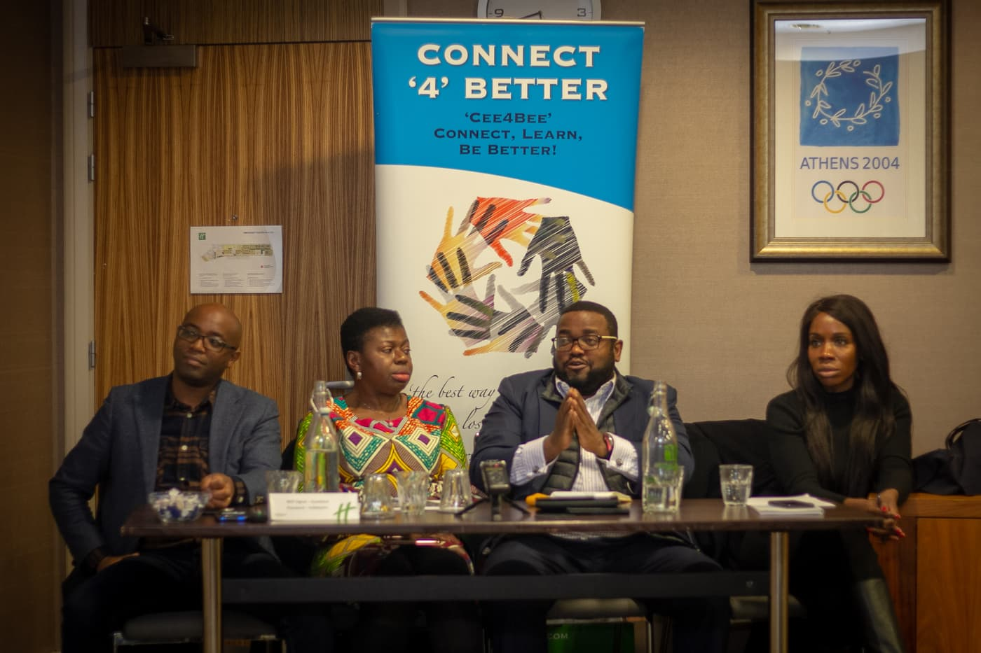
CEE4BEE 2.0
Closing the Exposure Gap
PEOPLE · PLACES · POSSIBILITIES · OPPORTUNITIES
Because exposure changes horizons, and horizons change lives.
cee4bee.com · info@cee4bee.com · @cee4beeuk
Cee4Bee · Registered charity in England and Wales 1174657 · Event photography by Terence A Francis / Tigz Media, ImCom, and other photographers who covered Cee4Bee events.

